Slide 1

DHANEKULA INSTTUTE OF ENGINEERING AND TECHNOLOGY
ELECTRICAL AND ELECTRONICS ENGINEERING
ENERGY SAVING USING TRAFFIC TURBINES
Our Team Members
N.D.Mahesh - 208T5A0209
B.Chaitanya - 208T5A0204
K.Mounish - 208T5A0215
V.Ganesh - 208T5A0239
A.Naveen - 198T5A0201
Under the guidance of
Mrs.V.Komali Mtech
Assistant professor

Slide 2
CONTENT :-
→ ABSTRACT
→ BLOCK DIAGRAM
→ WORKING
→ COMPONENTS
→ HARDWARE
→ TEST RESULTS
→ ADVANTAGES
→ FUTURE SCOPE

Slide 3
ABSTRACT :-
ENERGY SAVING USING TRAFFIC TURBINE
The main objective of our project is to design a wind turbine to recapture wind energy from vehicles on the highway. Wind energy is considered the fastest growing clean energy source however; it is limited by variable natural wind. Every year wind energy generation is increasing. Highways can provide a considerable amount of wind to drive a turbine due to high vehicle traffic. This kinetic energy is unused. Research on wind patterns was used to determine the average velocity of the wind created by oncoming vehicles is 60 – 90 mph. The wind turbines are designed to be placed on the medians therefore wind flow from both sides of the highway will be considered in the design. Moreover 20-30 mph is enough to create energy from the Traffic Turbine. The design of the turbines consists of blades, Buck-Boost convertor, collars, bearings, a shaft, gears and a generator. Additionally, since the wind source will fluctuate, a storage system for the power generated was designed to distribute and maintain a constant source of power. This power will be distributed to streetlights. Ideally, the turbine can be used globally as an unlimited power source for streetlights and other government applications.
KEYWORDS: Traffic turbine, Buck-Boost convertor, Energy storage system.

Slide 4
BLOCK DIAGRAM :-
Street lights
LDR
Arduino
Turbine
Gears
Relay module
WIND
DC
Generator
Battery
Ac to Dc converter
AC Supply

Slide 5
WORKING :-
Whenever the vehicles passed through the highways medians, it generates some wind along with them. If we place a traffic turbine in the medians of the highways, it will generate some energy. Which will be fed to the traffic lights to save the electrical Energy. And also ac supply will be taken and converted to dc by using ac to dc converter and then fed to the street light, In between these there will be a relay module which will be controlled by an Arduino based on the signal passed from LDR .In this way it will automatically switches from battery mode to dc supply mode based on the charge in the batteries.

Slide 6
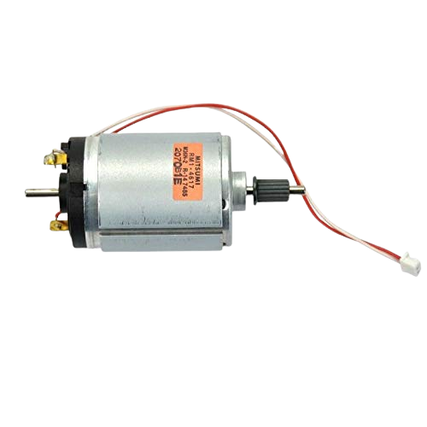
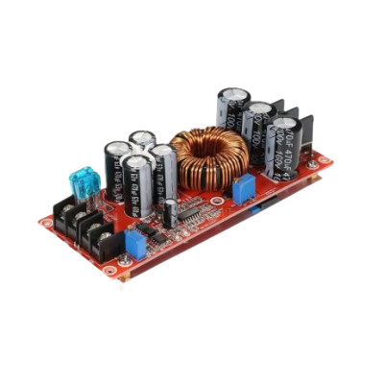
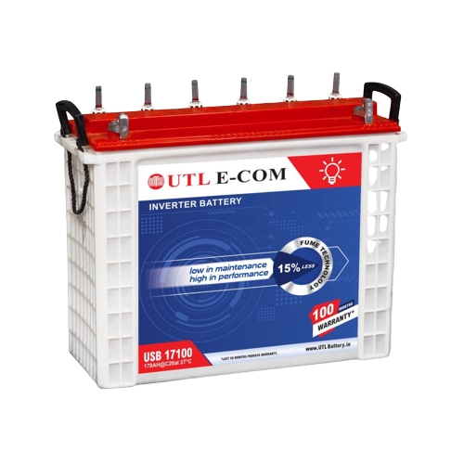

COMPONENTS :-
12-32 V DC generator
Ac-Dc convertor
Battery
DHANEKULA INSTTUTE OF ENGINEERING AND TECHNOLOGY
ELECTRICAL AND ELECTRONICS ENGINEERING

Slide 7

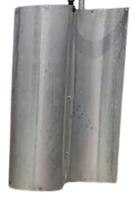
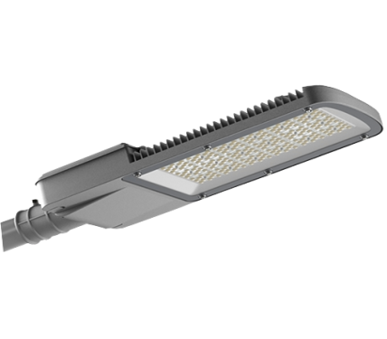
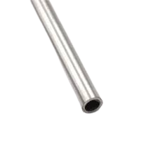
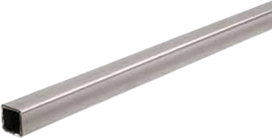
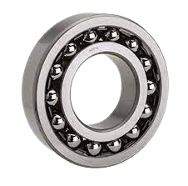
Gear Pinions
Led Street Light
Blades of Turbine
Bearings
¾ inch steel pipe
Square iron pipe

Slide 8
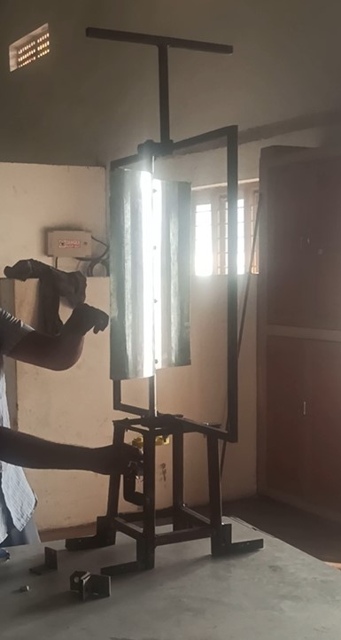
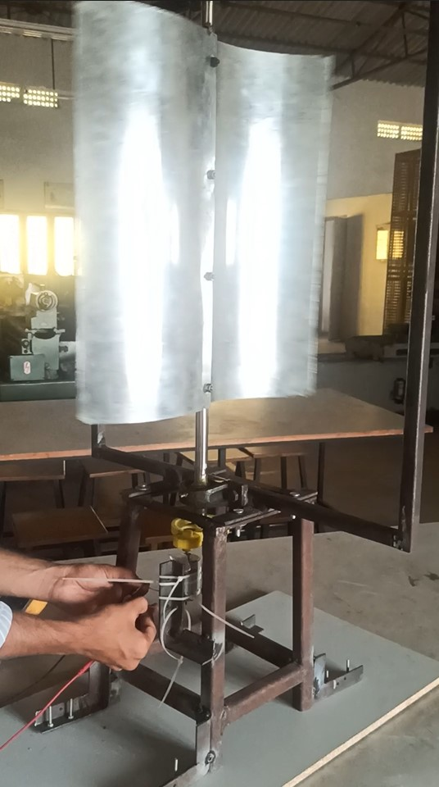
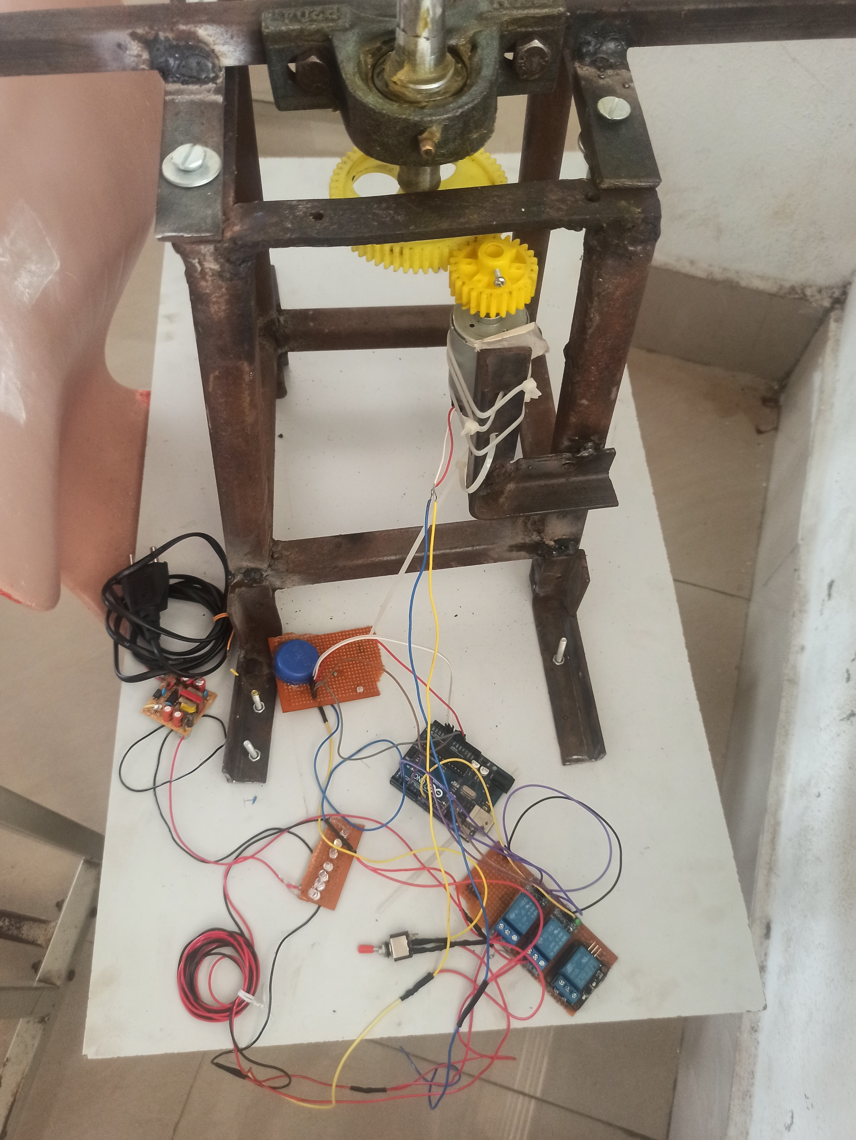
HARDWARE
PROJECT AFTER ASSEMBLING

Slide 9
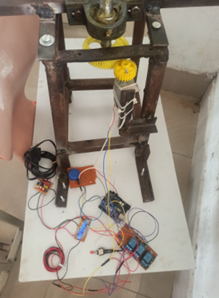
TESTING RESULTS :-
OFF CONDITION
BATEERY MODE
DC SUPPLY MODE

Slide 10
ADVANTAGES:-
there is no need of pointing the turbine in the wind direction.
It is efficient because the yaw drive and pitch mechanism are not needed.
It will Automatically change the supply whenever it is required to change from Battery to ac supply.
There is no need to transfer the Energy generated from the Traffic turbine.

Slide 11
FUTURE SCOPE AND CONCLUSION :-
The supply change over circuit needs to sense the LDR signal throught out the whole day, The power consumption will be less but not negligible.
To overcome this situation we want to activate the supply changing circuit on specific timings like 6 pm to 6 am in our future project implementation.

Slide 12
THANK YOU
ALL

